Slide 1


The Czech National Programme on Conservation and Utilization of Genetic Resources of Microorganisms Important for Agriculture
Petr Komínek, Iva Křížková, Marcela Komínková
Crop Research Institute

Slide 2
The Czech National Programme on Genetic Resources of Microorganisms Important for Agriculture
is directed by Czech Ministry of Agriculture
The aim:
  conservation of genetic resources of microorganisms ex situ in collections, safe maintaining of the genetic resources and their biodiversity
  record keeping and documentation of genetic resources, their evaluation on molecular level and possibility of utilization for agriculture
  enhancing the international cooperation, exchange of genetic resources
  Twenty - the member collections of NP constitute a network for ex situ preservation of microbial diversity (genetic resources.) in the Czech Republic
  Currently, there are maintained more than 6.5 thousand of accessions. Culture strains of microorganisms kept in collections are heterogeneous as regards concerning their taxonomy, applications and methods of conservation.

Slide 3
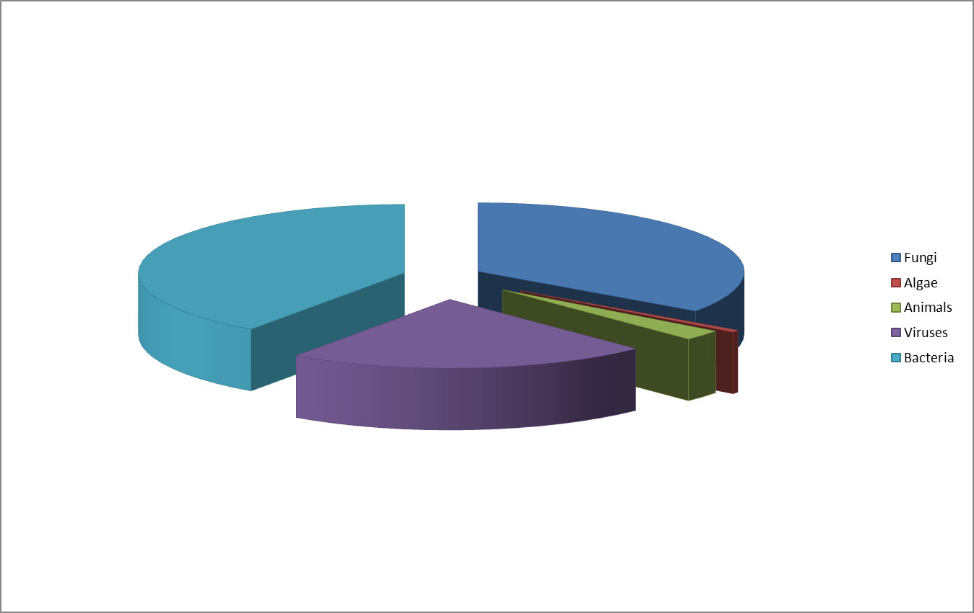
Bacteria constitute the biggest group of maintained microorganisms, closely followed by fungi and viruses. Two collections rear animals – arthropods (mites and insects) that are pests of stored food and feed products and plant pathogenic nematodes.

Slide 4
Culture strains can be divided into two groups concerning to their usefulness and harmfulness.
Fourteen collections maintain viruses, bacteria and fungi pathogenic to plant and animals.
Remaining 6 collections hold beneficial microorganisms, such as brewery yeast strains, lactic acid bacteria and yeasts involved in fermenting dairy products, fungi from basidiomycetes group utilizable for bioremediation of soil, ethanol fermentation yeasts, beneficial nitrogen-fixating rhizobia, baker’s yeasts and other yeasts and bacteria used for special production in food industry.

Slide 5
The National Programme consists from 20 collections of genetic resources held in 12 different bodies:
Collection of Plant Pathogenic Viruses (Crop Research Institute Prague - CRI)
Collection of Potato-Pathogenic Viruses (Potato Research Institute Havlickuv Brod)
Collection of Fruit Trees and Small Fruit Viruses (Research and Breeding Institute of Pomology Holovousy)
Collection of Ornamental Plant Viruses (Research Institute for Landscape and Ornamental Gardening Pruhonice - RILOG)
Collection of Phytopathogenic Bacteria (CRI)
Culture Collection of Rhizobia (CRI)
Collection of Phytopathogenic Fungi (CRI)
Culture Collection of Basidiomycetes Important for Agriculture (Institute of Microbiology, Academy of Sciences, Prague)
Culture Collection of Fungi Important for Agriculture and Food Industry (Charles University Prague)
Collection of Fungi Important for Horticulture – Macromycetes (CRI)
Collection of Rusts and Powdery Mildew (CRI)
Collection of Phytopathogenic Microorganisms (Palacky University Olomouc)
Collection of Brewery Microorganisms (Research Institute of Brewing and Malting Prague)
Culture Collection of Dairy Microorganisms (MILCOM a.s. Tabor)
Collection of Industrially Utilizable Microorganisms (Food Research Institute Prague)
Collection of Animal Pathogenic Microorganisms (Veterinary Research Institute Brno)
Collection of Hop Pathogens (Hop Research Institute Zatec)
Collection of Invertebrate Crop Pests and their Natural Enemies (CRI)
Collection of Stored-Product Pests, Mites and Fungi (CRI)
Collection of Phytopathogenic Oomycetes (RILOG)

Slide 6
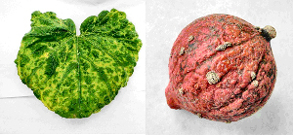
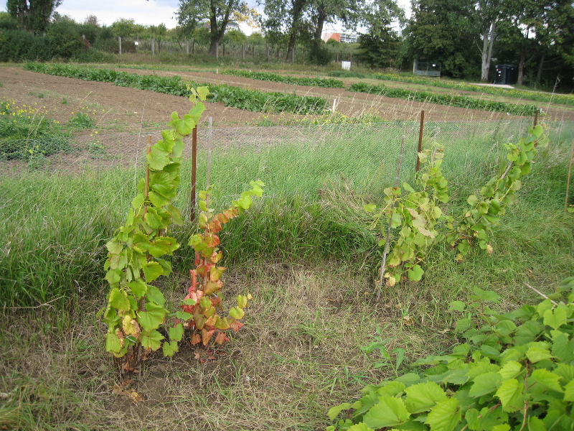
Collection of Plant Pathogenic Viruses
(Crop Research Institute Prague - CRI)
Viruses infecting:
- fruit trees
- grapevine (Vitis vinifera L.)
- vegetables
- cereals
68 isolates
Zucchini yellow mosaic virus on pumpkin cv. Hokkaido

Slide 7
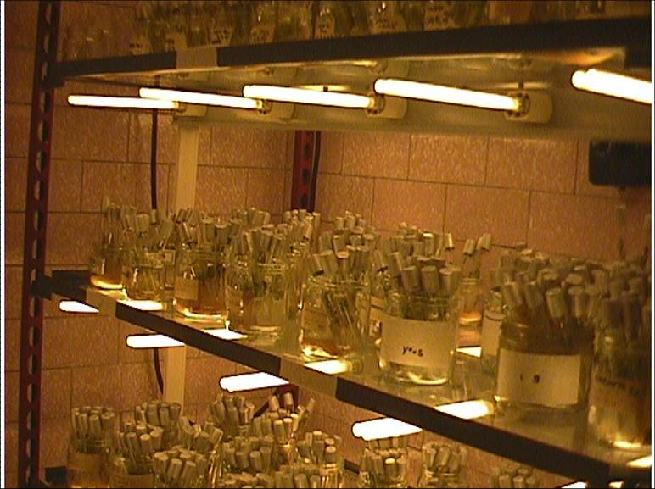
Collection of Potato-Pathogenic Viruses
(Potato Research Institute Havlickuv Brod)
541 isolates,
- all maintained in vitro
- viruses and viroid infecting potatoes
110 isolates of Potato virus Y
collection of viruses preserved in tissue culture

Slide 8
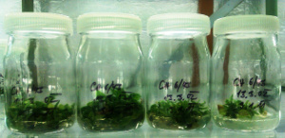
Collection of Fruit Trees and Small Fruit Viruses (Research and Breeding Institute of Pomology Holovousy)
collection specialized in fruit tree viruses
109 isolates
collection of viruses preserved in tissue culture

Slide 9
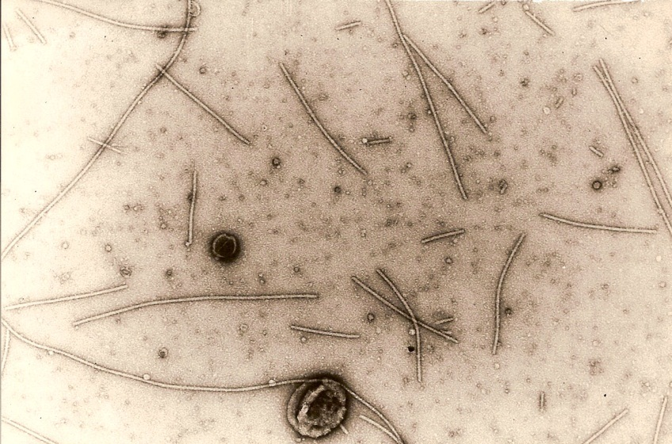
Collection of Ornamental Plant Viruses
(Research Institute for Landscape and Ornamental Gardening Pruhonice - RILOG)
viruses of ornamental plants
96 isolates
Chrysanthemum virus B

Slide 10
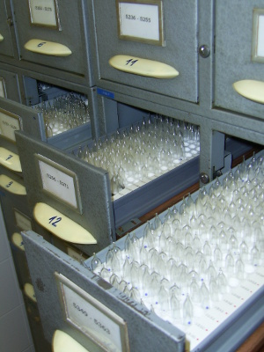
Collection of Animal Pathogenic Microorganisms
(Veterinary Research Institute Brno)
Unique collection of animal viruses and zoopathogenic bacteria
useful for veterinary practice,
- applied microbiology
- research.
578 virus strains
1374 bacteria strains
storage of lyophilised cultures

Slide 11
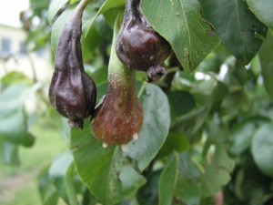
Collection of Phytopathogenic Bacteria
(CRI)
682 bacterial isolates
Erwinia amylovora
Clavibacter michiganensis
Xanthomonas ssp.
Pseudomonas ssp.
Erwinia amylovora on pears

Slide 12
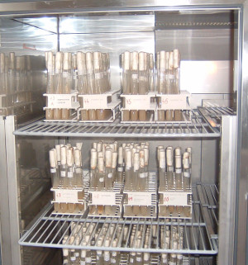
Collection of Rhizobia
(CRI)
bacteria able to fix atmospheric nitrogen in symbiosis with legumes
mainly Rhizobium
500 isolates
stored culture of rhizobia

Slide 13
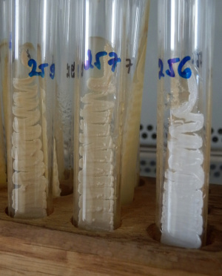
Collection of Industrially Utilizable Microorganisms
(Food Research Institute Prague)
Industrially Utilizable Microorganisms
bacteria, yeasts and fungi of food industry and agriculture importance
production of baker’s and feed yeasts
production of food additives, enzymes
microbiological methods of analyses
130 fungi, 17 bacteria
bacterial culture isolated from foods

Slide 14
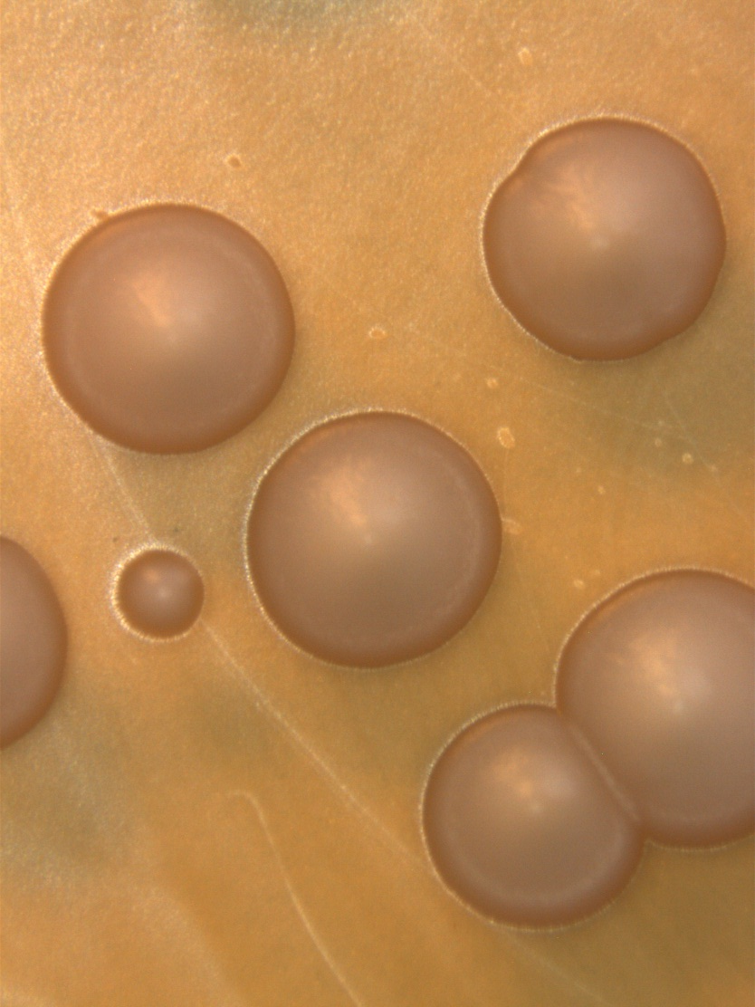
Collection of Brewery Microorganisms
(Research Institute of Brewing and Malting Prague)
Brewery microorganisms
brewing yeasts
winery and wild yeasts
bacteria
unique collection in Central and East Europe
173 isolates
Saccharomyces pastorianus

Slide 15
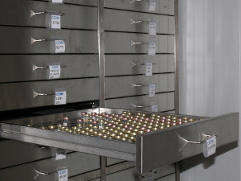
Culture Collection of Dairy Microorganisms
(MILCOM a.s. Tabor)
cultures for fermented diary products
mainly Lactobacillus, Bifidobacterium
almost 900 strains
supply cultures for educational institutions and research
lyofilized bacterial cultures

Slide 16
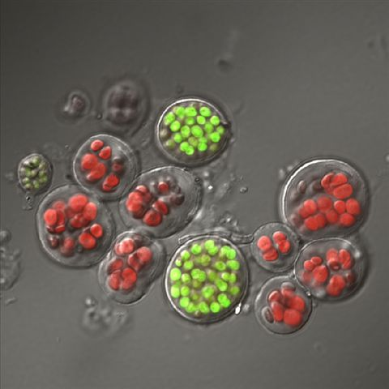
Collection of Phytopathogenic Microorganisms
(Palacky University Olomouc)
179 fungi
31 algae
16 viruses
6 phytoplasmas
unique collections of :
Bremia lactucae (70 isoaltes)
Pseudoperenospora cubensis (57 isolates)
Cyanobacterium, Gloeocapsa

Slide 17
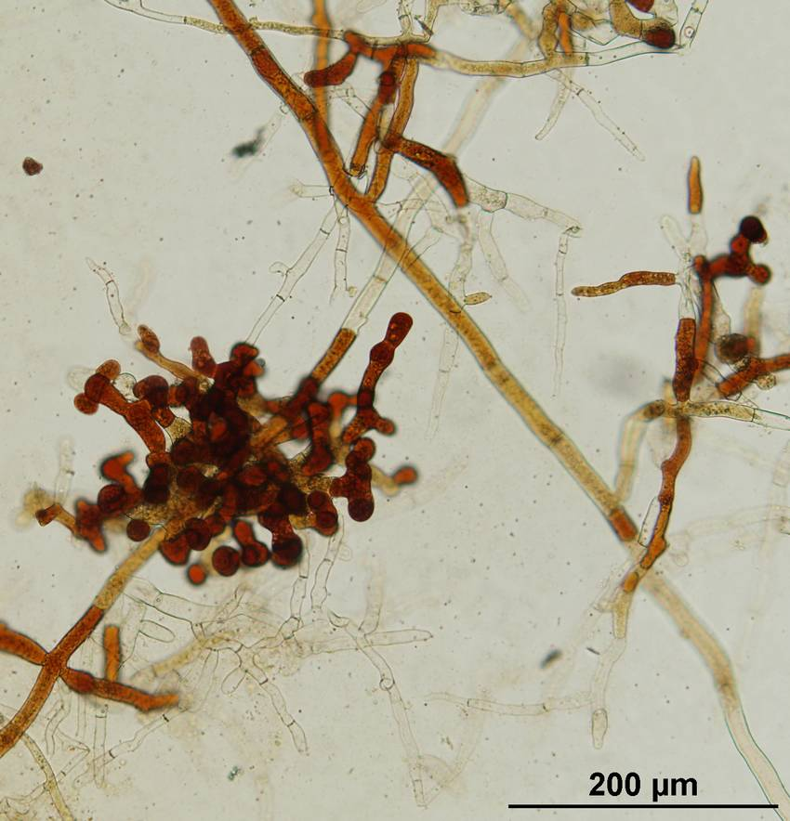
Collection of Fungi Important for Horticulture – Macromycetes
(CRI)
Macromycetes
Ascomycetes edible mushrooms (Morchella, Verpa)
horticultural mycotechnologies
microsclerotia of Morchella

Slide 18
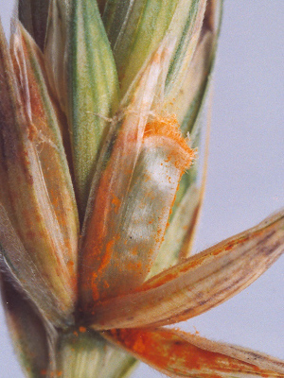
Collection of Rusts and Powdery Mildew
(CRI)
Rusts and Powdery Mildew
biotrophic cereal pathogens
wheat resistance testing
utilized by breeders and authorities
695 isolates
Puccinia striiformis

Slide 19
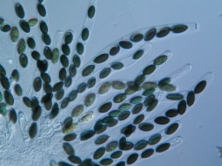
Collection of Phytopathogenic Fungi
(CRI)
Fungi
- phytopathogenic
- potentially phytopathogenic,
- mycotoxinogenic
- potentially mycotoxinogenic
- edible and medicinal mushroom grown by Czech farmers,
especially from groups Deuteromycota, Ascomycota and Basidiomycota
390 isolates
Sordaria fimicola

Slide 20
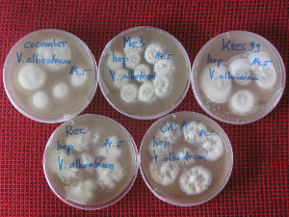
Collection of Hop Pathogens
(Hop Research Institute Zatec)
8 virus isolates
1 fungus isolate
Verticilium alboatrum

Slide 21
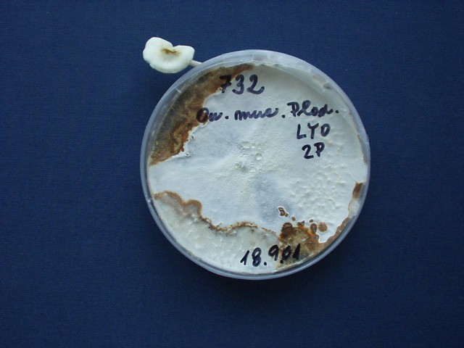
Culture Collection of Basidiomycetes Important for Agriculture
(Institute of Microbiology, Academy of Sciences, Prague)
Basidiomycetes:
potential to decompose polutants (organic compound) with their enzymes
metabolize pesticides thanks to extracellular enzyme lacasa
thus help with bioremediation of contaminated soil
332 isolates
Oudemansiella mucida, sporocarp

Slide 22
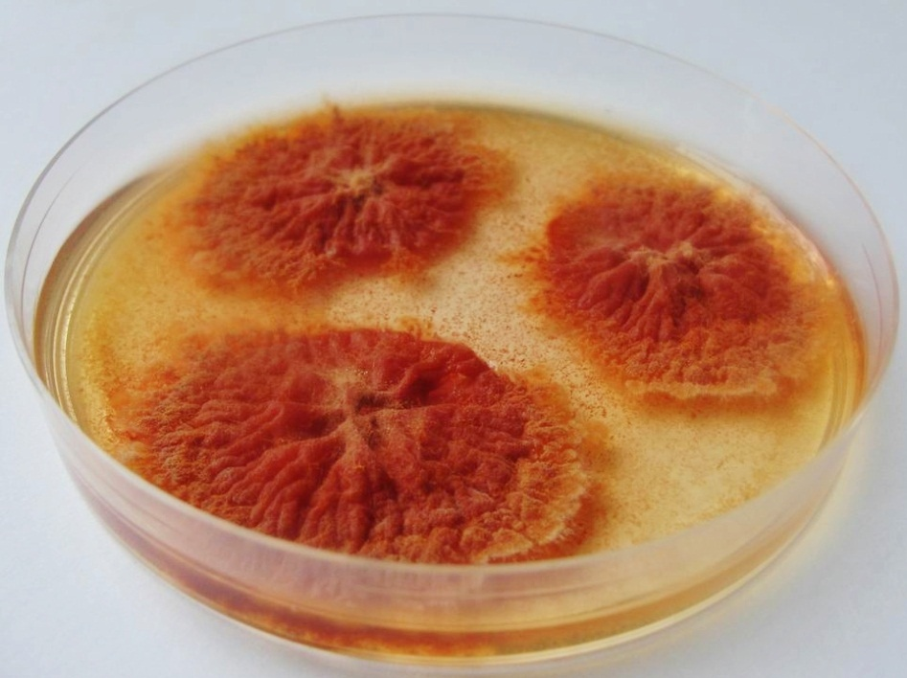
Culture Collection of Fungi Important for Agriculture and Food Industry
(Charles University Prague)
Saprotrophic microfungi (Ascomycetes and Zygomycetes):
food contaminants
mycotoxins producers
insects associated fungi
297 isolates
Monascus purpureus

Slide 23
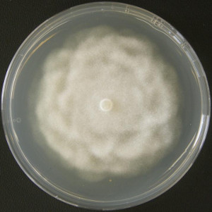
Collection of Phytopathogenic Oomycetes
(RILOG)
302 isolates
mainly Phytophthora ssp.
Phytophthora cryptogea

Slide 24
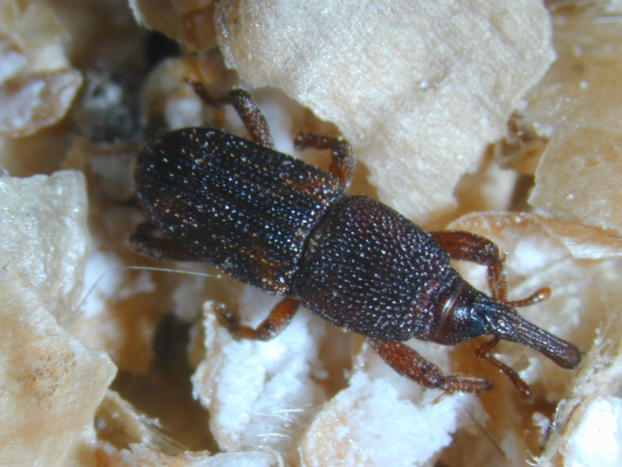
Collection of Invertebrate Crop Pests and their Natural Enemies
(CRI)
Invertebrate
insect crop pests
their natural enemies
plant pathogenic nematodes
30 species
breeding living animals
Sitophilus oryzae

Slide 25
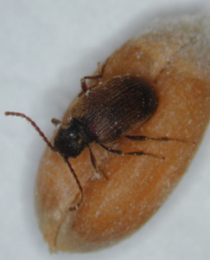
Collection of Stored-Product Pests, Mites and Fungi
(CRI)
- stored product insects and mites
- standards for evaluating of sensitivity or resistance to insecticides
129 species
Ptinus tectus

Slide 26
Thanks for your attention.

